Slide 1
Strategy Pattern
Nguyen Ba Khoi

Slide 2


Slide 3
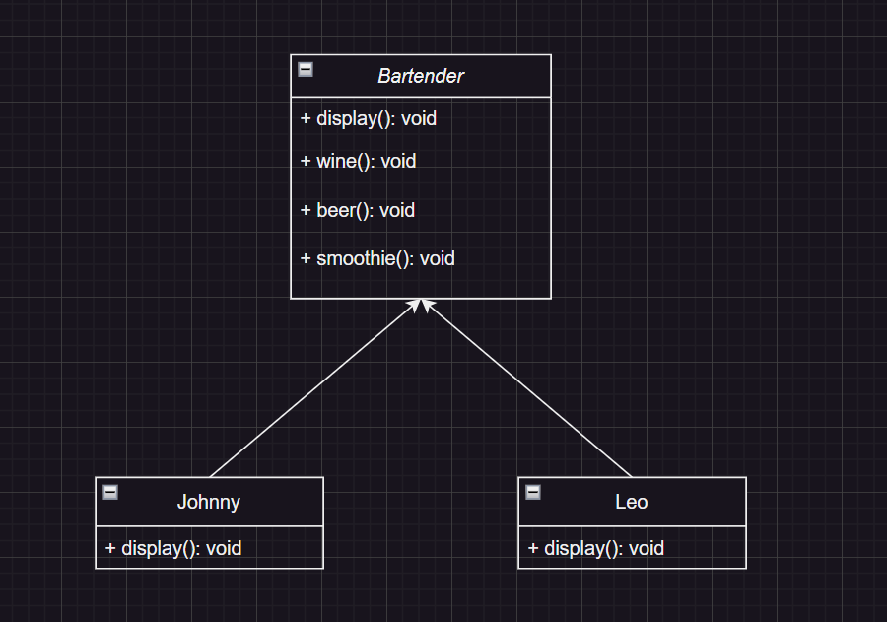

Slide 4
How about an interface?
Notes:
An interface describes the behavior or capabilities of a C++ class without committing to a particular implementation of that class.

Slide 5
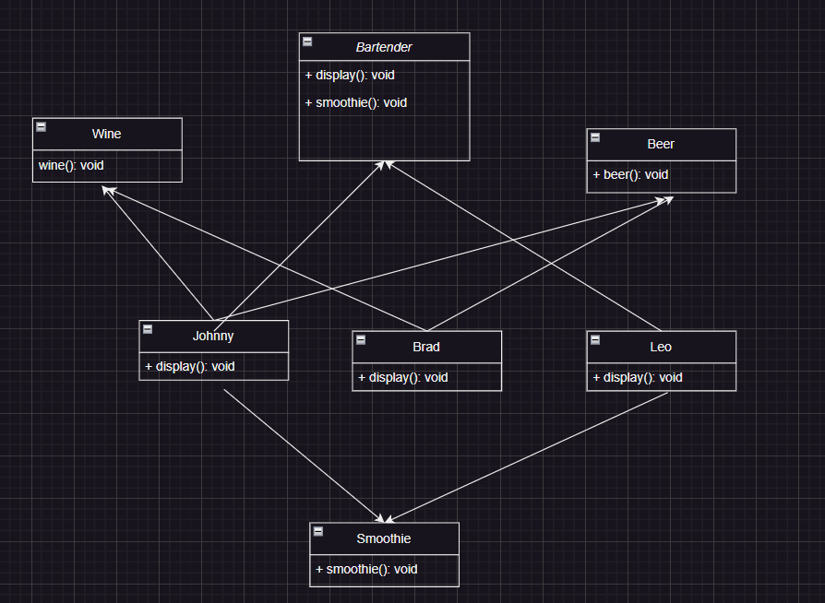

Slide 6
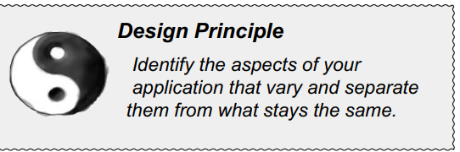
Notes:
As simple as this concept is, it forms the basis for almost every design pattern. All patterns provide a way to let some part of a system vary independently of all other parts

Slide 7
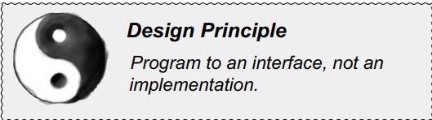

Slide 8
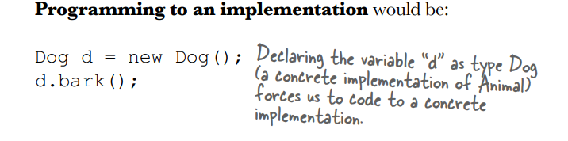
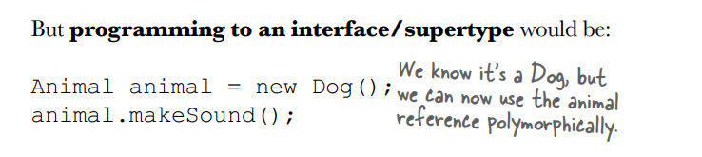

Slide 9
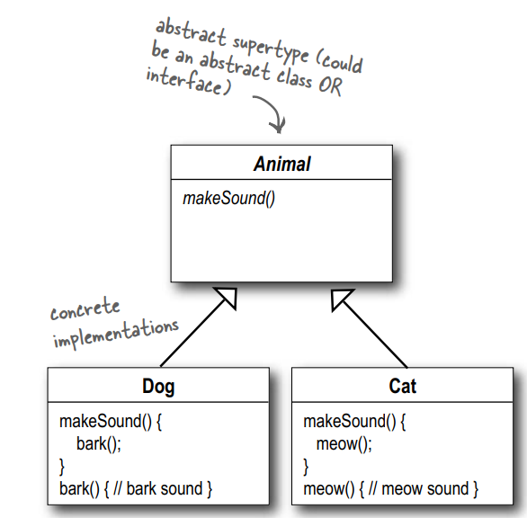

Slide 10
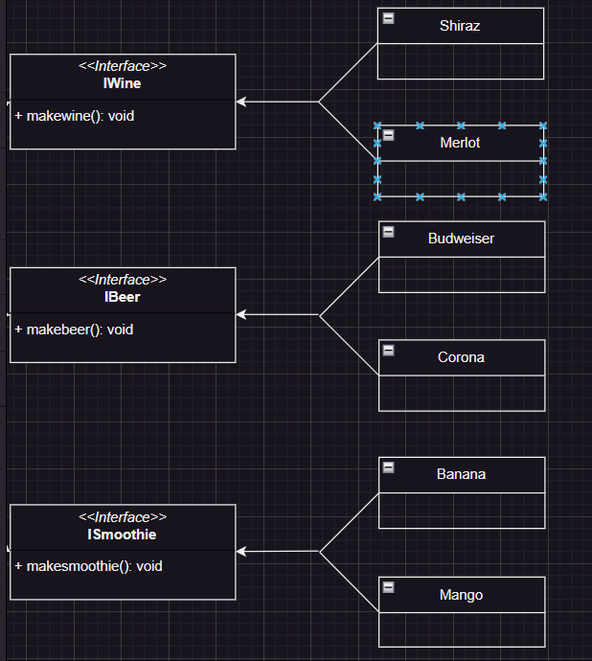
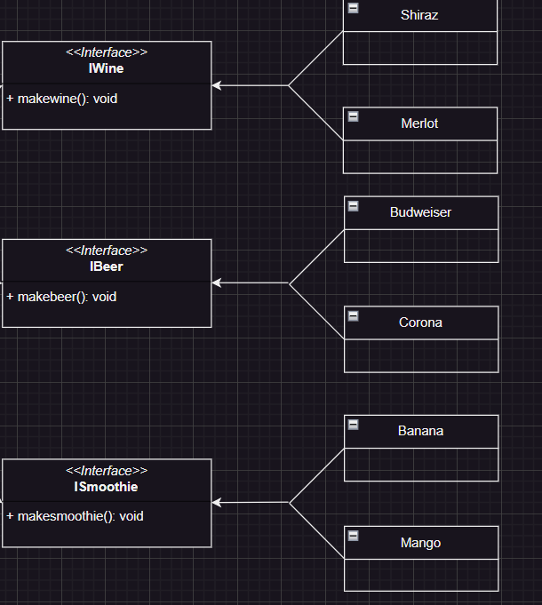

Slide 11
